Slide 1
FitWise: Smart Workout Builder and Exercise Analytics
FitWise – Workout Tracking Web App Milestone #3 Presentation Presented by: Emmanuel Dairo CS499 Senior Seminar April 14, 2026

Slide 2
What is FitWise?
FitWise is a full-stack workout tracking web app that helps users:
Log workouts (sets, Reps, Weight)
Automatically classify exercises
Track Volume, streaks, and personal records
create training insights
Manage progression over time
Why this project? I built this because I already track my workouts, and I wanted a structured system that stores data and helps analyze progress.
FitWise is a full-stack application that allows users to log workouts, track sets, reps, and weight, and manage their training data. In addition to basic tracking, the system also provides analytics like volume, streaks, and personal records, helping users better understand their performance. Originally, this project focused on simple tracking, but I expanded it to include analytics and insights

Slide 3
Tools and Technologies Used
FastAPI (backend)
SQLite (database)
React (frontend UI)
Fetch API (Communication)
Uvicorn (server)
The system is built using FastAPI for the backend, SQLite for data storage, and React for the frontend. The frontend communicates with the backend using the Fetch API, and the application is ran locally using Uvicorn. These tools allowed for fast development and smooth integration.

Slide 4
Implementation Techniques
Full CRUD system implemented
Automatic exercise classification system
Workout data stored with timestamps
Frontend dashboard with analytics
Input validation and error handling
now the system is fully implemented with full CRUD functionality. The backend handles data storage, validation, and classification, while the frontend gives users an interactive interface for logging and analyzing workouts. Compared to the last milestone #2, I added features to the system to include analytics and data tracking

Slide 5
System Workflow
User inputs workout in frontend
Data sent to backend API
Backend classifies and stores data
Data retrieved and displayed
Dashboard updates in real time
The system works through a simple workflow. The workflow begins when a user enters workout data in the frontend. That data is sent to the backend API, where it is validated, classified, and stored in the SQLite database. The data is then retrieved and displayed in the frontend, and the dashboard updates in real time.

Slide 6
Key Features
Progression charts
Training insights
Dark / light mode
Muscle group tracking
Automatic classification
Volume calculation
Personal record tracking
Streak Tracking
1 RM = W x (1 + R/30)
The system includes several key features such as automatic exercise classification, volume calculation using sets, reps, and weight, personal record tracking, streak tracking, muscle group analysis, progression charts, training insights, and a dark and light mode

Slide 7
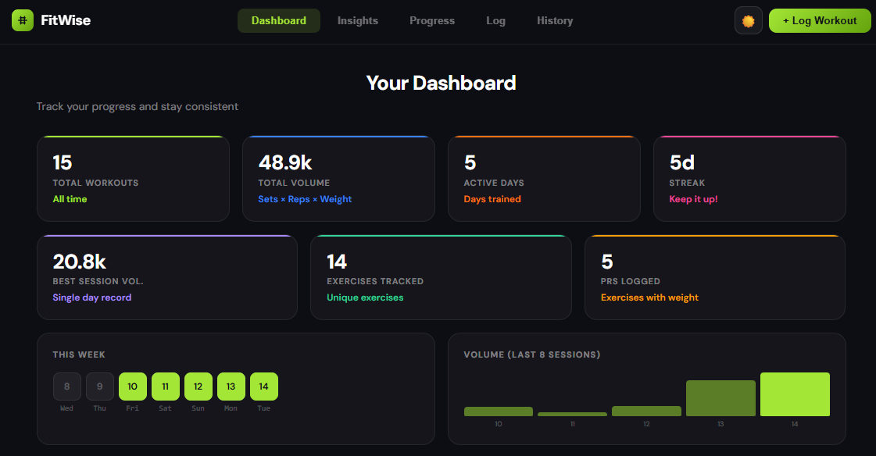
Key Features
Automatic exercise
classification
Training insights
Progression Tracking
Charts & strength
development
One improvement I added different from the original plan was an automated exercise classification feature that categorizes workouts between 7 muscle groups in real time. This adds a level of intelligent processing to the system, instead of having to use manual input. Another major addition was training insights and progression tracking. The system analyzes workout data to identify trends such as most trained muscle groups, consistency, and performance improvements

Slide 8
Testing & Validation
Validation
Empty inputs rejected
Invalid values handled
Verified
Create operation
Retrieve operation
Update operation
Delete operation
To make sure the system works correctly, I tested all CRUD operations including create, retrieve, update, and delete. I also tested validation by entering invalid inputs such as empty fields and incorrect values to confirm that the system handles errors properly

Slide 9
System Status & Results
System fully functional end-to-end
Data stays in database
Real-time analytics working
Insights generated from workout data
The final system is fully functional with a connected frontend and backend, persistent data storage, real-time updates, and analytics. It not only stores workouts but also processes and interprets them to provide useful feedback to the user

Slide 10
Conclusion
Full-stack workout tracking system
Real-time analytics and insights
Intelligent classification system
progression tracking and data analysis
FitWise demonstrates a full-stack system that turns workout tracking into a more intelligent and analytical experience that makes it easy for users to stay fit

Slide 11
THE END thank you

